Slide 1


HTTP vs HTTPS: Securing the Web
Explore the critical differences between HTTP and HTTPS, the protocols that power the web.
Puneet Kumar

Slide 2

HTTP: The Foundation of Web Data Exchange
HyperText Transfer Protocol
Client-Server Model
Insecure
Request-response protocol for web data
Browser sends request, server responds.
Data can be intercepted on the network.

Slide 3





HTTPS: Secure Web Communication
HTTP + SSL(Secure Sockets Layer)
Encryption for secure data exchange
Secure Handshake
SSL certificate verifies identity.
Encrypted Data
All data is transmitted securely.

Slide 4

SSL Certificate: Verifying Identity
Website Identity
Encryption
Verifies the site's identity.
Enables secure encryption.
Issued by Certificate Authority (CA)

Slide 5
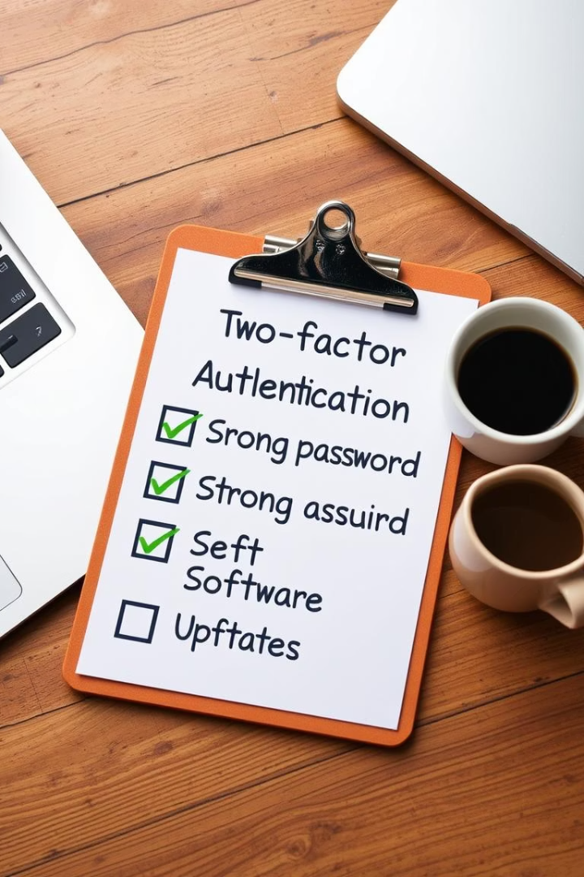





Advantages of HTTPS: Security and Trust
Encryption
Authentication
Data Integrity
Keeps data private.
Verifies website.
Detects tampering.

Slide 6



Disadvantages of HTTPS: Performance and Cost
Slightly Slower
1
SSL Certificate
Encryption overhead.
2
May incur a cost.

Slide 7

Key Takeaways: Secure Your Web Presence
HTTPS is Essential
SSL Certificates
For secure web communication.
Verify website identity.
Prioritize Security
Build user trust.

Slide 8

Real-World Analogy
HTTP: The Postcard
HTTPS: The Sealed Envelope
Imagine sending a postcard with sensitive data. Anyone can read the message during delivery.
Sending a sealed envelope guarantees that only the recipient can read the contents.
This is how HTTP works. Data is transmitted in plaintext, unencrypted, and visible to others.
HTTPS encrypts data, ensuring private information remains confidential during transmission.

Slide 9

Internet Control Message Protocol
Internet Control Message Protocol is known as ICMP. The protocol is at the network layer.
It is mostly utilized on network equipment like routers and is utilized for error handling at the network layer. Since there are various kinds of network layer faults, ICMP can be utilized to report and troubleshoot these errors.
Since IP does not have an inbuilt mechanism for sending error and control messages. It depends on Internet Control Message Protocol(ICMP) to provide error control. In this article, we are going to discuss ICMP in detail along with their uses, messages, etc.

Slide 10

Position of ICMP in the network layer

Slide 11
TYPES OF MESSAGES
ICMP messages are divided into error- reporting messages and query messages. The error-reporting messages report problems that a router or a host(destination) may encounter.

Slide 12
TYPES OF MESSAGES

Slide 13
MESSAGE FORMAT
An ICMP message has an 8 – byte header and avariable-size datasection . Although the general format of the header is different for each message type, the first 4 bytes are common to all.

Slide 14
ERROR REPORTING
Ip, as an unreliable protocol, is not concerned with error checking and error control. Icmp was designed, in part, to compensate for this shortcoming. Icmp does not correct errors, it simply reports them.

Slide 15
Contents of data field for the error messages

Slide 16
Destination-unreachable format

Slide 17
Destination-unreachable format
Destination-unreachable messages with codes 2 or 3 can be created only by the destination host.
Other destination-unreachable messages can be created only by routers.

Slide 18
Source-quench format
A source-quench message informs the source that a datagram has been discarded due to congestion in a router or the destination host.
The source must slow down the sending of datagrams until the congestion is relieved.

Slide 19
Time-exceeded message format
In a time-exceeded message, code 0is used only by routers to show that the value of the time-to-live field is zero. Code 1is used only by the destination host to show that not all of the fragments have arrived within a set time.

Slide 20
Parameter-problem message format
A parameter-problem message can be created by a router or the destination host.

Slide 21
Redirection concept

Slide 22
Redirection concept
A host usually starts with a small routing table that is gradually augmented and updated. One of the tools to accomplish this is the redirection message.
A redirection message is sent from a router to a host on the same local network.

Slide 23
QUERY
ICMP can also diagnose some network problems through the query messages, a group of four different pairs of messages. In this type of ICMP message, a node sends a message that is answered in a specific format by the destination node.

Slide 24
Timestamp-request and timestamp-reply message format
Timestamp-request and timestamp-reply messages can be used to calculate the round-trip time between a source and a destination machine even if their clocks are not synchronized.
The timestamp-request and timestamp-reply messages can be used to synchronize two clocks in two machines if the exact one-way time duration is known.

Slide 25
CHECKSUM
In ICMP the checksum is calculated over the entire message (header and data).
Example of checksum calculation

Slide 26
ICMP PACKAGE
To give an idea of how ICMP can handle the sending and receiving of ICMP messages, we present our version of an ICMP package made of two modules : an input module and an output module.

Slide 27
Thank You for your attention

